Slide 1
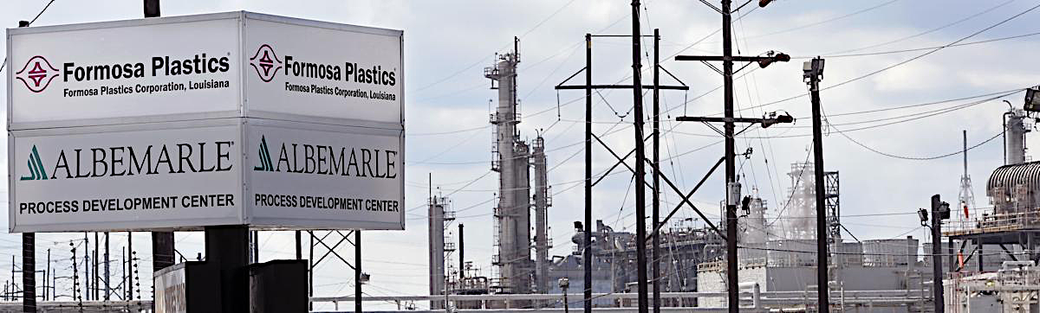
Formosa Plastics
Powder MI Prediction and Analysis Model for Polypropylene
Team B – Final Presentation
Advisors
Client
Bowen Wang
Jinyang Gu
Penglin Du
Xinyue Yu
Cong Sun
Lillian Liao
Xin Wei
Yankun Zhao
Renzo Silva Elijah Hall
Formosa Plastics

Slide 2








Team B
Bowen Wang
Cong (George) Sun
Jinyang (Patrick) Gu
Lillian Liao
Penglin (Daniel) Du
Xin Wei
Xinyue (Sally) Yu
Yankun (Gary) Zhao
We are young professionals from Columbia University Applied Analytics with strong analytical skills and rich experience in dealing with mega data and model building. We are an energetic team with strong passion in bringing change to the real-world problems.

Slide 3
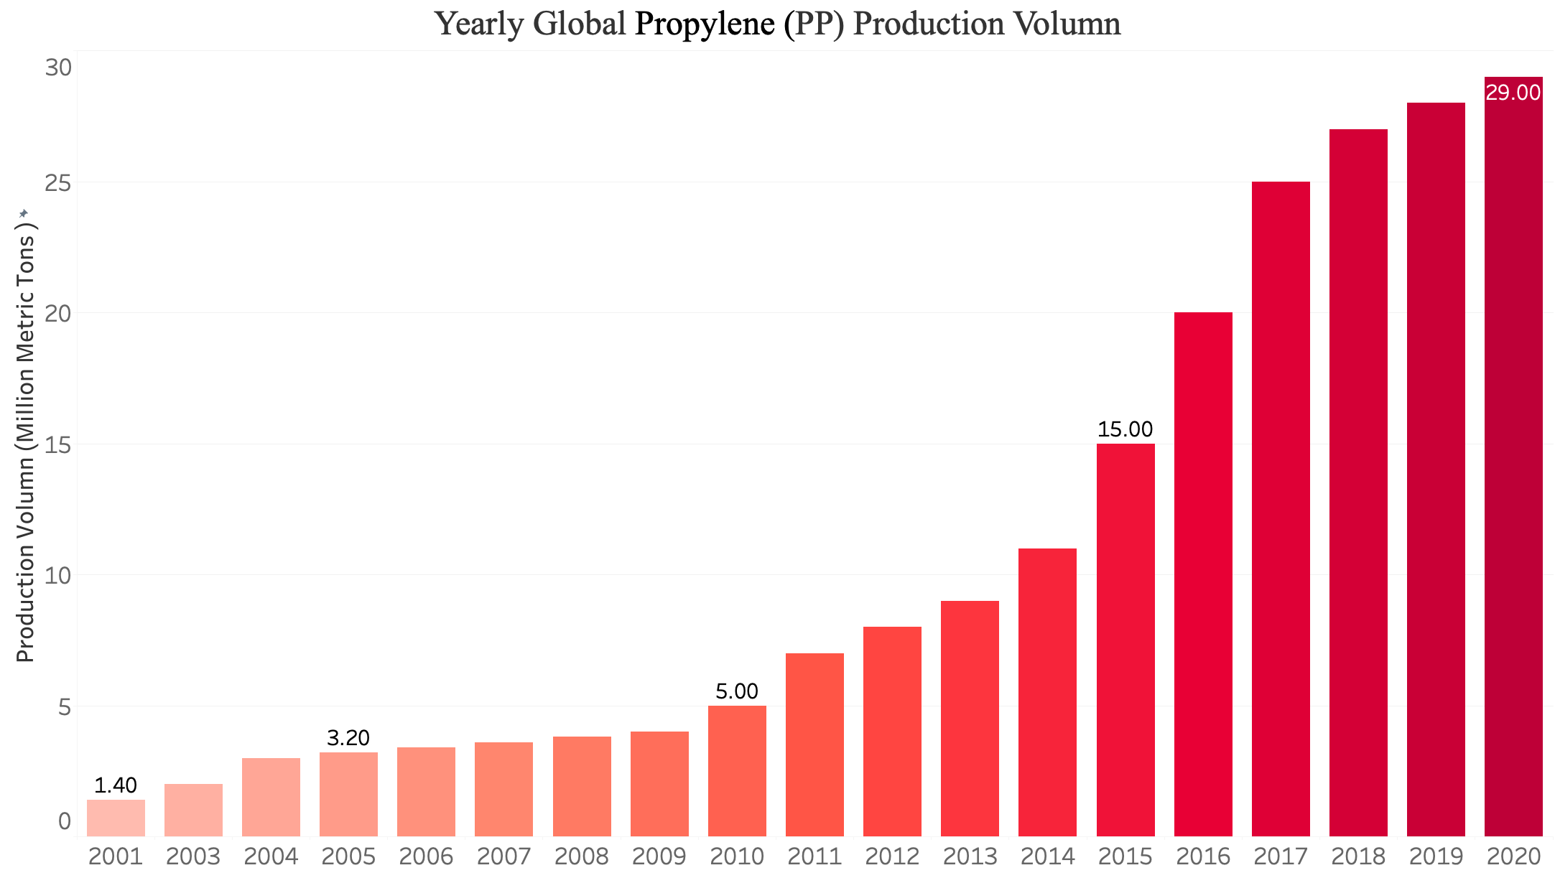







Identifying Improvement Options Through Initial Research
” Supply the highest quality products and services to our customers…… maintain global competitiveness, achieve healthy, continual growth that will benefit society……"
Background
Polypropylene Market
Founded in 1978
2,900 Employees
$5 billion in Revenue
Main Products
$97 billion MKT size in 2018
6.0% CAGR until 2026
Increasing demands in packaging industry
Polyethylene
Caustic Soda
Polyvinyl Chloride
Polypropylene
Global pp Production Volume (2001 - 2018)
Manufacturing Plants Location
Livingston, New Jersey
Competitive Landscape
Point Comfort, Texas
Baton Rouge, Louisiana
Reduce or reuse production wastes
Integrating AI and other technologies

Slide 4


Current Model indicates an inefficiency and requires changes
Current Manufacturing Process
Further Concern
The R700 Product Line at the Texas plant only produces polypropylene (PP) of various types.
Input
Switching products causes an abnormal MI value and cannot be immediately noticed by the current method.
Long Lag period return to normal after abnormality being detected
it will take a relatively long time to bring the MI value back to normal.
Approach & Methods
Propylene
Hydrogen
Catalyst
. . .
Vacuum
Tank
Pressure Relief
Tank
MANUAL
SAMPLING
Reactor
Related Areas that Await Changes
Setting
Temperature
Humidity
. . .
Facilitate manufacturing cycle to reduce waste production
Project Architecture
Current Model Problems
Optimize content ratio for smarter procurement
Increase revenue
Raise brand reliability
Measurement time: every 4 hours
A late notice of the abnormal MI value
Waste by producing degraded products
problems
Notes:
Melt flow index (MI value) is a measure of the ease of flow of the thermoplastic polymer melt (Singh, Kumar, Feo, & Fraternali 2016) and determines the grade of the product.

Slide 5
Our Project goal is to construct a Real-time Powder MI Prediction System with AI Model to improve MI value accuracy above 80%
Objective 1
Objective 2
Objective 3
Optimize Manufacturing
Prevent Wasteful Production
Reduce Production Cost
Environment Setting
Down-graded Product
Raw material & energy usage
Content Ratio
Labor needed
Manual Sampling
Supply chain efficiency
Timelines
Delivery Conclusion
Delivery Design and Visualization
Data Exploration Hypothesis Testing
1. Automated
Real-time Powder MI
Prediction System
2. System Instruction
3. Project Report
Industry and Market Research
Sep 20
Oct 11
Nov 1
Nov 22

Slide 6
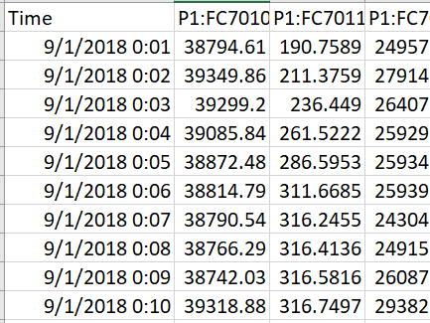
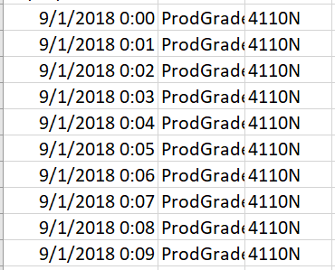
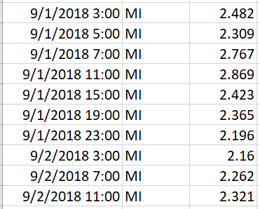
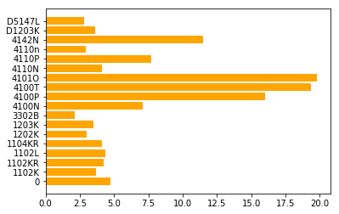
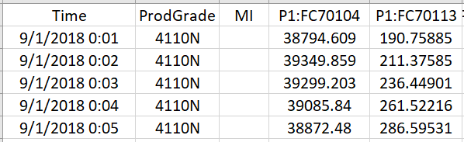
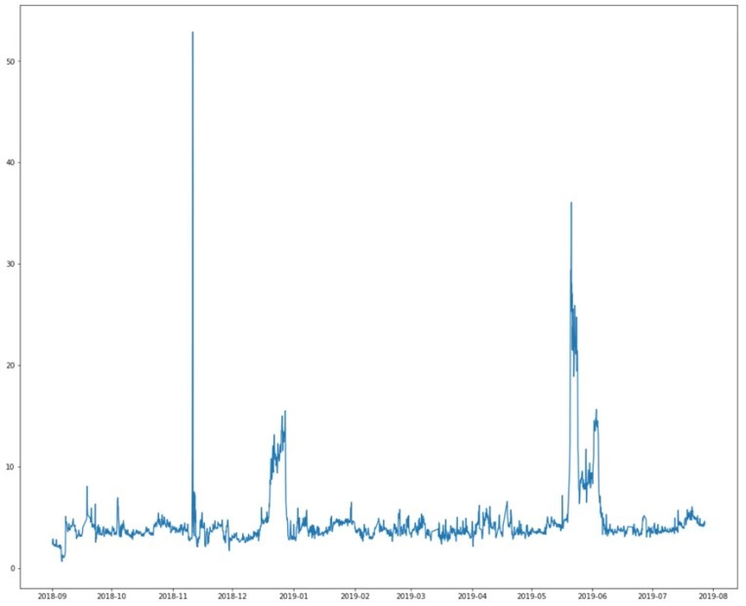
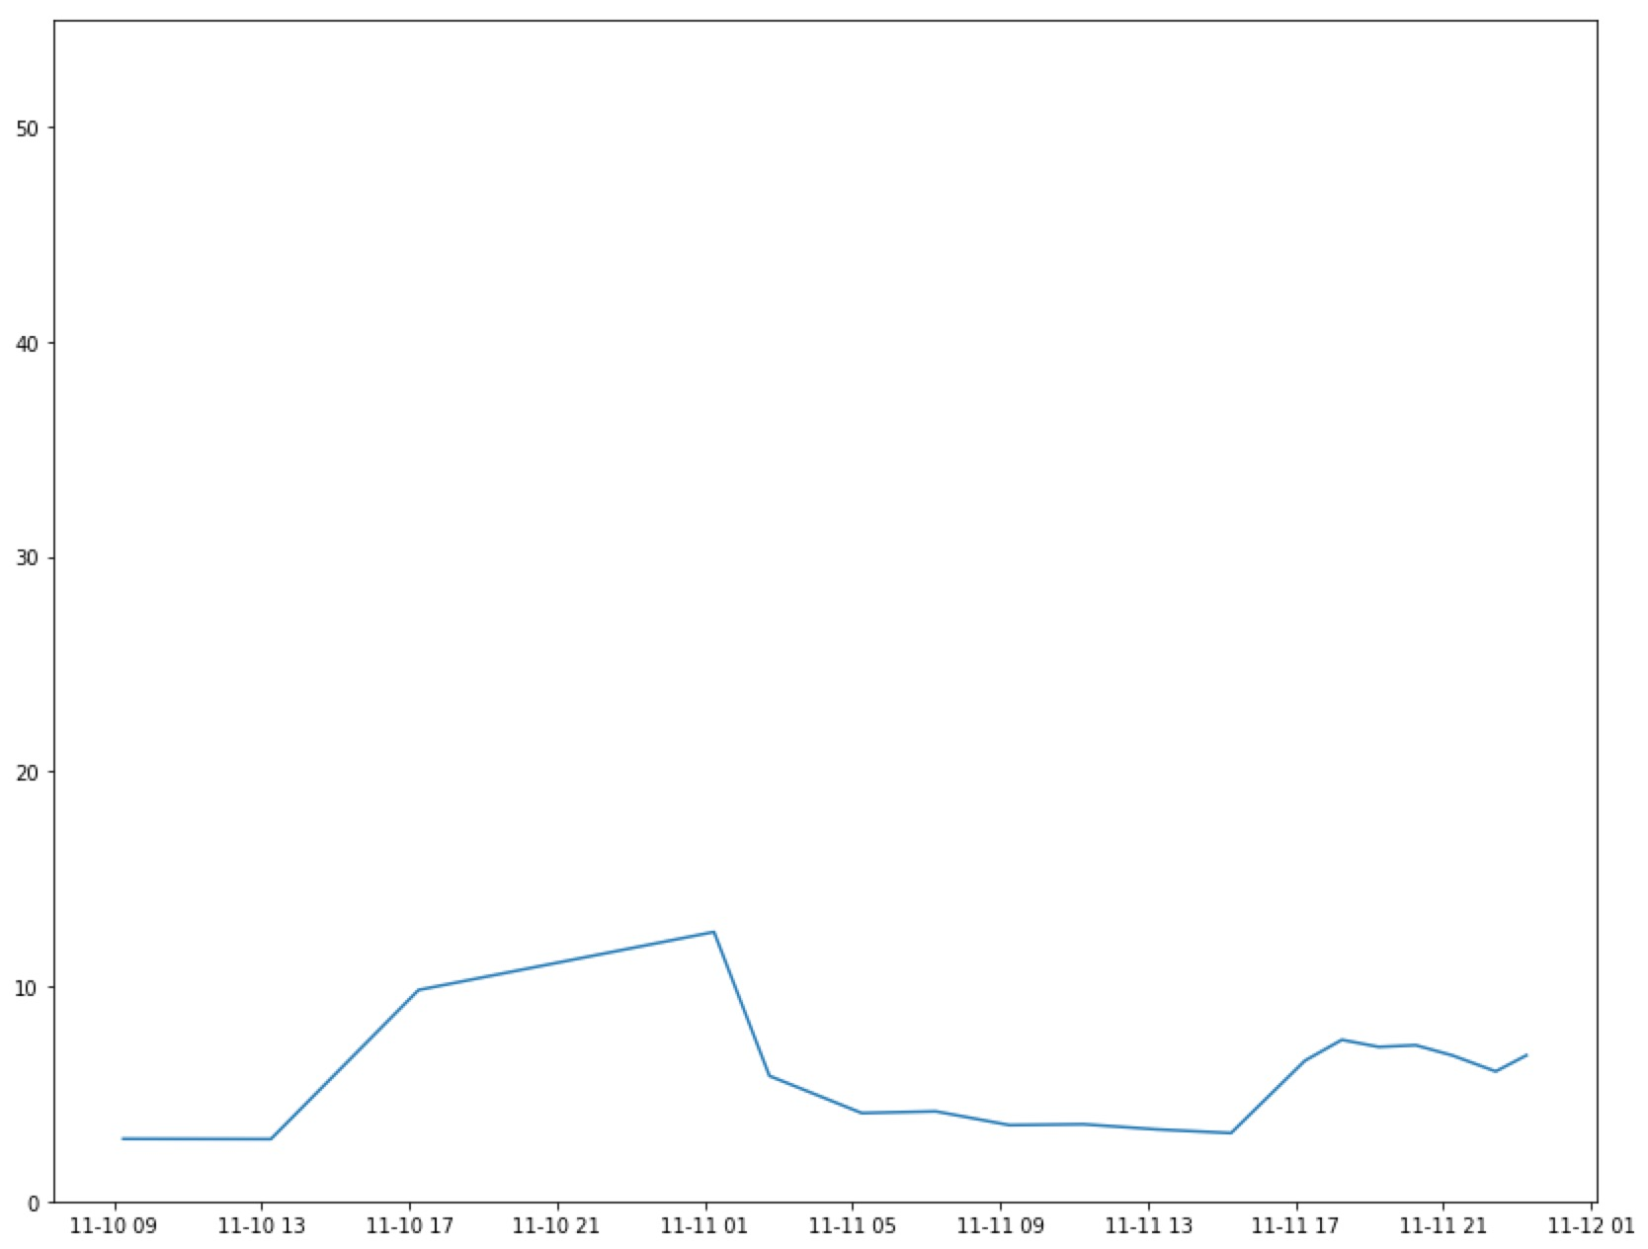
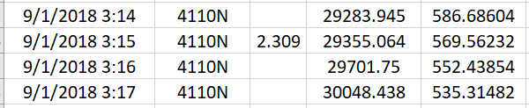
Data Cleaning
Join
Missing Values
Left Joined the “MI QC” and “Tag” dataset with the common column “time”
Cleaned out 168 observations with N/A values
Tag Data
168 missing values detected
Getting rid of all
MI QC Data
Subtract 105 Minutes
Outliers
Cleaned out 2 spikes in exploring MI values
Outliers compared with the average MI value in this ProdGrade
The tallest spike: mean MI of 7.5
…
Excel “Vlookup” Function
The second tallest spike: mean MI < 5
…
…
Remove two since neither of these product grades has too few values
…
Merged Data

Slide 7
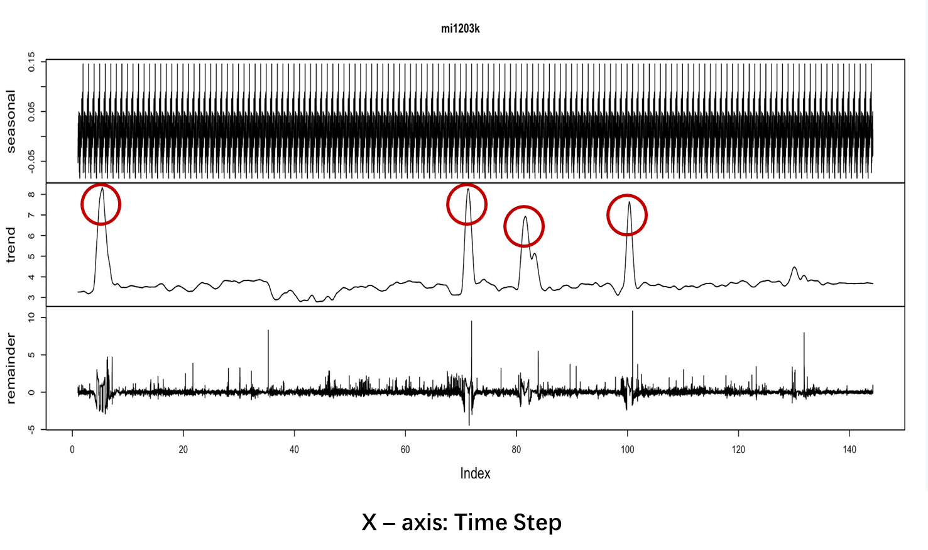
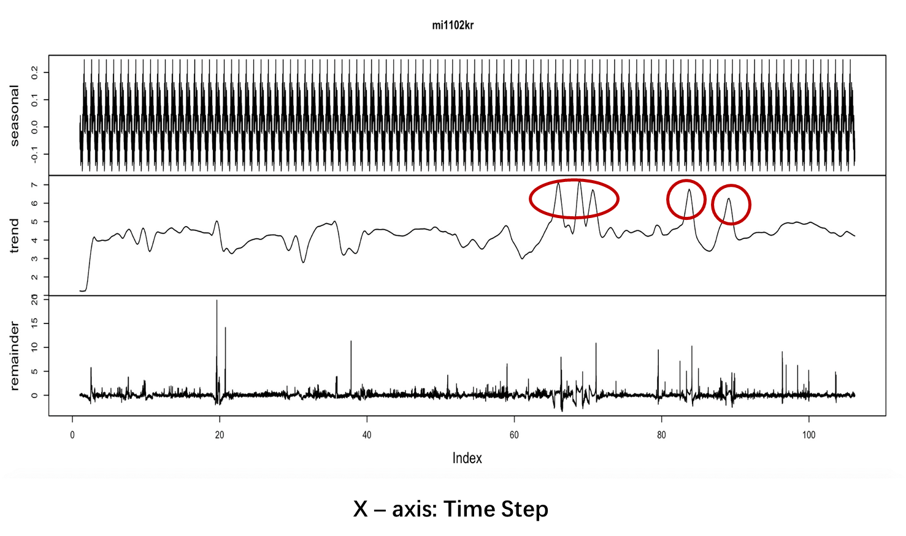
First Data Exploration - Time series
No notable seasonality and trend in the data
Switching products causes an abnormal MI value
The MI value will not return to normal after the abnormal MI value will cause a relatively long reaction time to set the MI value back to normal

Slide 8
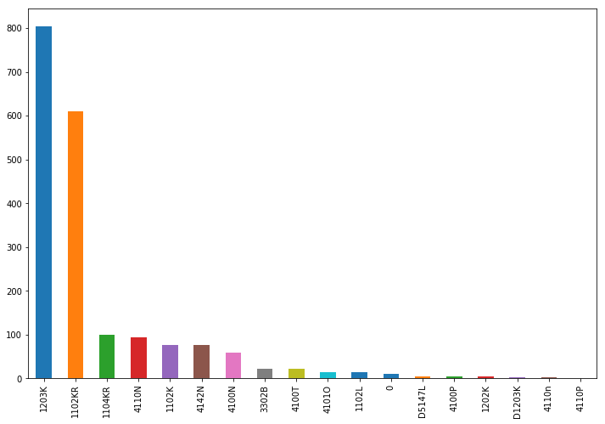
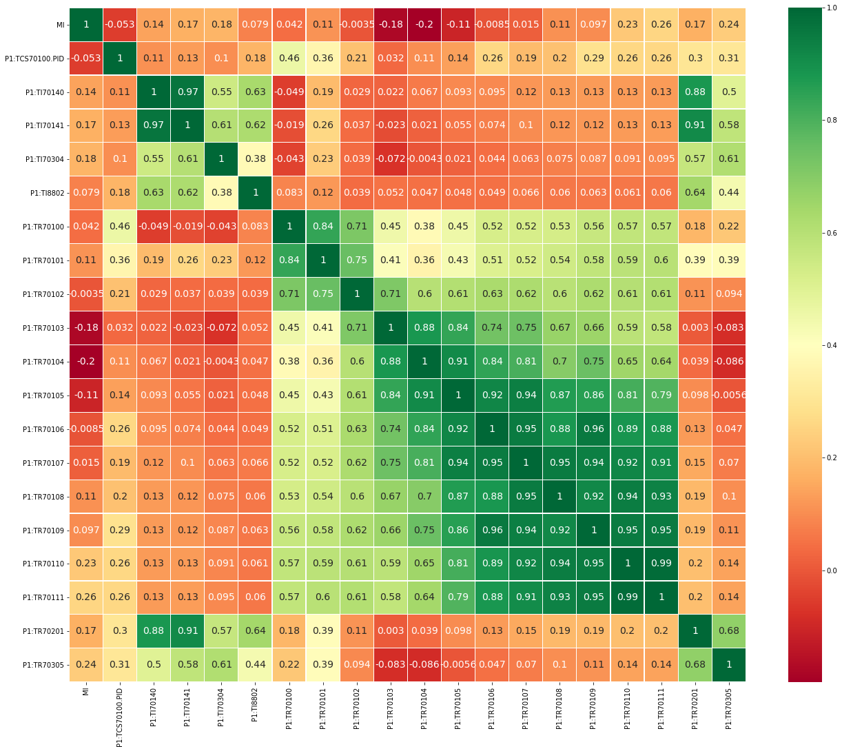
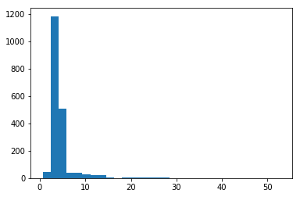
Data Exploration
The graph suggests that most products belong to two grades
MI value is highly correlated with 20 variables (60 in total)
The number of the observations for each product grade
Distribution of product MI value
Variables that have >= |0.1| correlation with powder MI after standardization

Slide 9
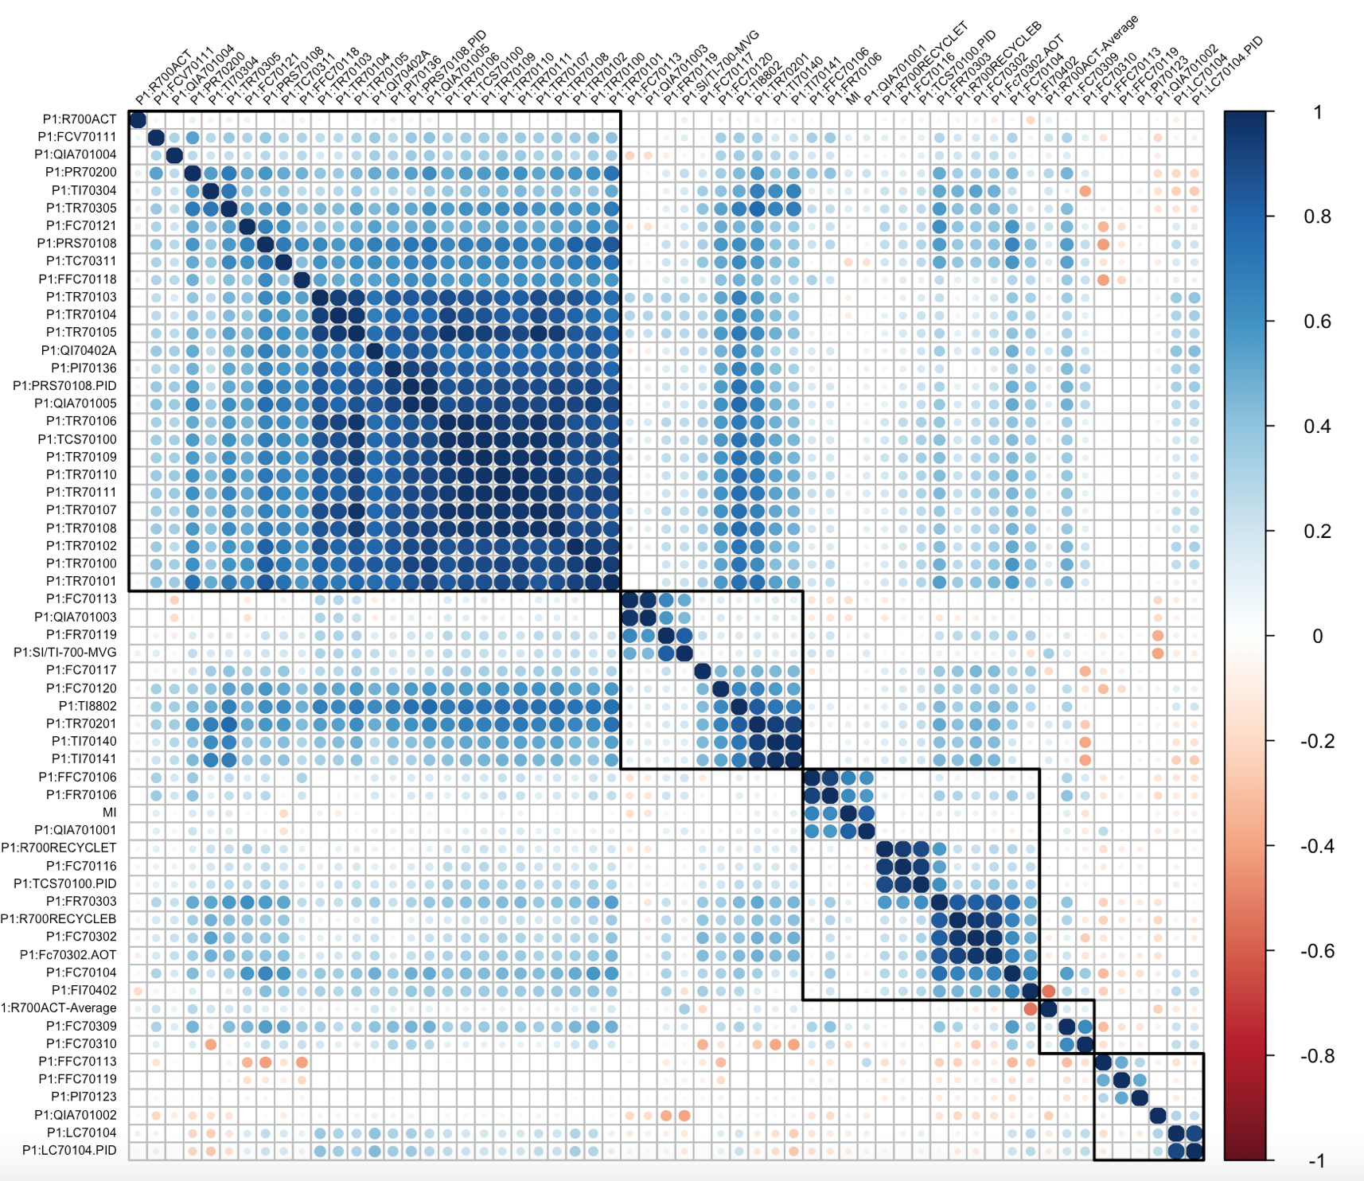
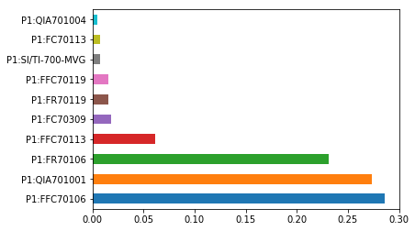
Data Modeling
The Analysis Using Linear Regression
The Analysis Using Random Forest
RMSE
Multicollinearity
All variables except
Time and ProGrade
5.95
Initial Linear Model
Top 10 variables that have high
correlation with powder MI
3.85
Top 10 variables
high correlational variables adding interactions
2.82
From the important plot we can see which features are important to random forest model
Best random forest model: 0.73 RMSE
Advanced Linear Model
All variables with normalization
Multiple factors are correlated not just to the response variable, but also to each other.
1.76

Slide 10
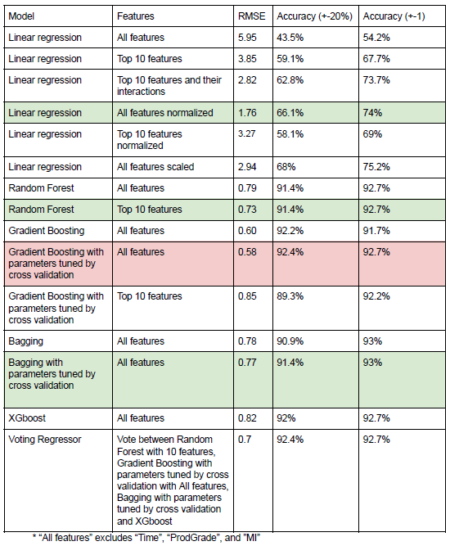
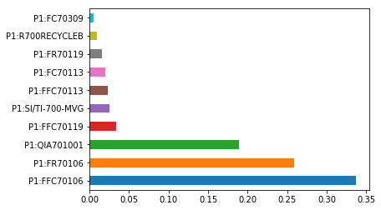
Based on the result, we found that the Gradient Boosting Model (GBM) with all variables performs the best, with the lowest RMSE and highest accuracy in both means.
The Analysis Using Gradient Boosting
92.7% accuracy
Default parameters
grid search to tune for the best parameters
Run with the top 10 most important features
worse performance
The top most important features
Keep all features
The advantages of using GBM
Robust to overfitting
Can more accurately and stably predict the MI value.
processes data faster and easier
Reduce unnecessary computing burden and latency

Slide 11
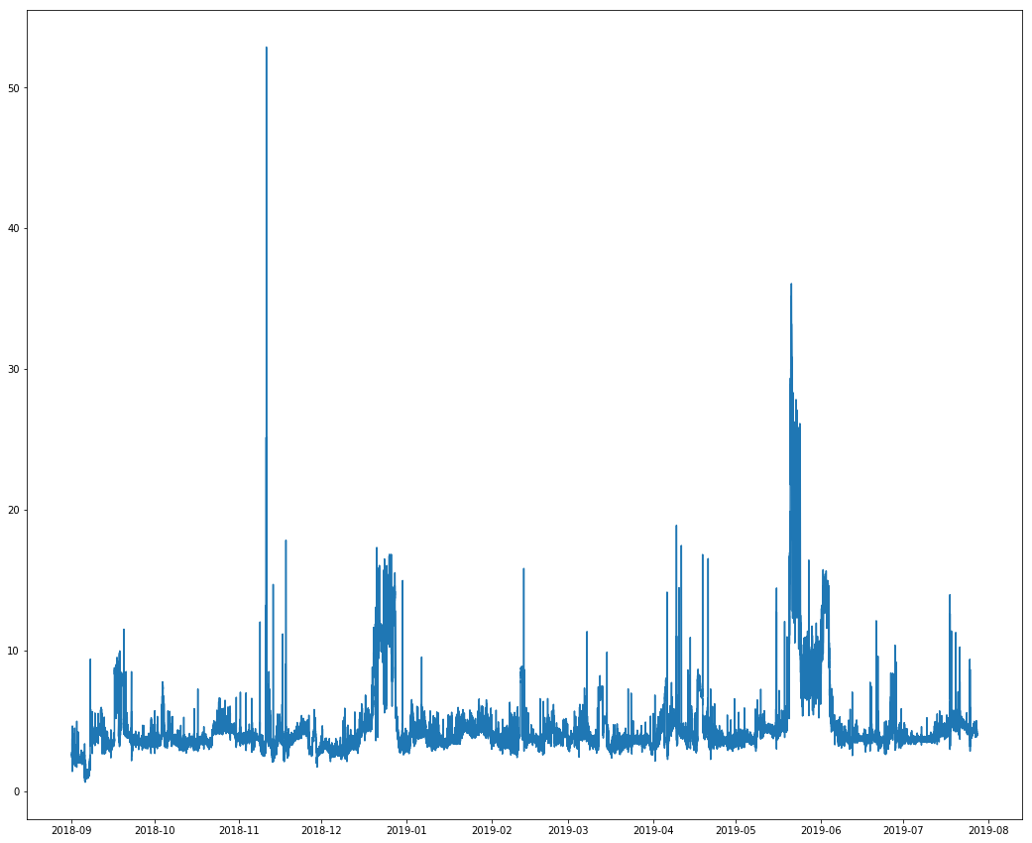
Comparing the actual time series plot of MI values (4h) with our predicted model ( 1 minute), we can see there shows a high similarity between the two
We fill the missing values using the gradient boosting values with the prediction per minute – the time series plot of MI values
The actual time series plot of MI values

Slide 12
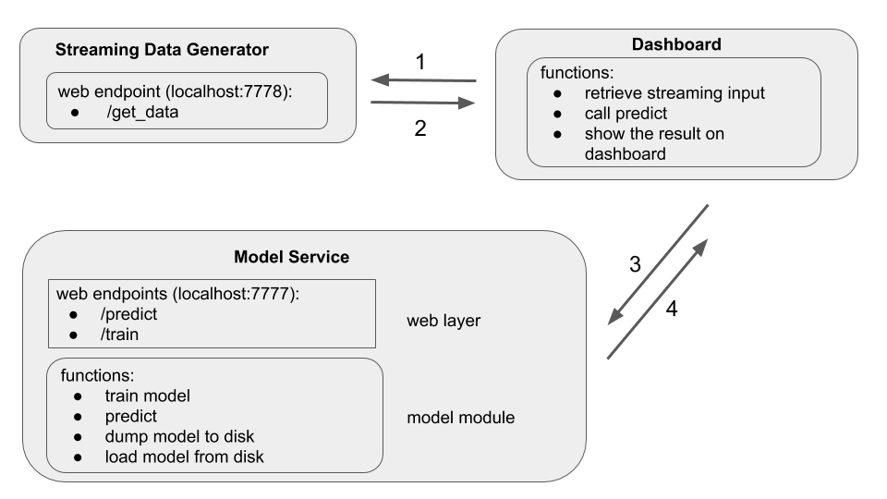
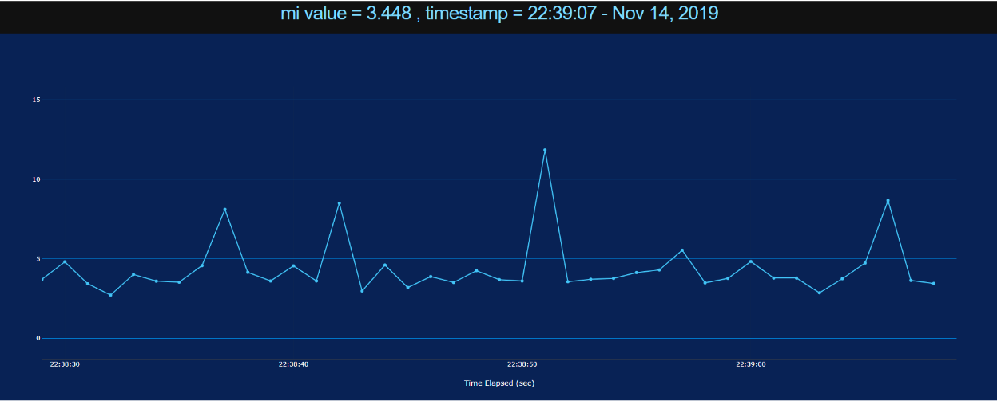
To better meet the needs of users, our group decided to design a real-time dashboard, which can leverage the model and reflect the MI value in a real-time basis
The dashboard's operating mechanism
A snapshot of the dashboard
Mechanism
The dashboard calls input from streaming data generator
Streaming data generator sends input back to the dashboard
The dashboard sends input and calls for prediction
The prediction is sent back and shown on the dashboard

Slide 13
Technology Risks
Mitigations
Lack of full understanding of the given factors leads to a inefficiency of work and future errors
The data we used for building the model is not large enough to result in solid solutions or recommendations
Cannot 100% replace the physical MI value measurement in short time
The model cannot be scaled to other products rather than Polypropylene
If the MI is biased due to the physicals measurement error, the accuracy of the model will also be affected
V
The group will do more research to prevent the potential risks from happening
Further model testing and learning can be applied after receiving more recent data
Further collaborations and works need to be done
V
V

Slide 14
Thank You

